Slide 1


DNA is the genetic material
Lecture 2
Dr. Rawa Abdul Redha Aziz
Ph.D Antibiotics/ Molecular biology

Slide 2
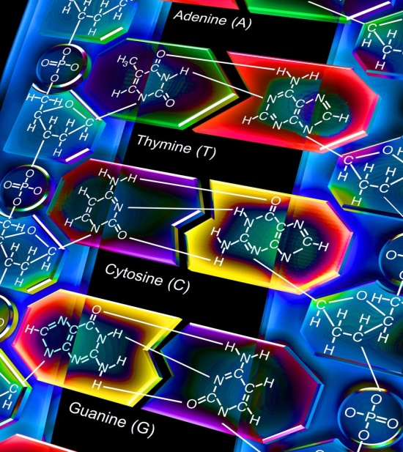
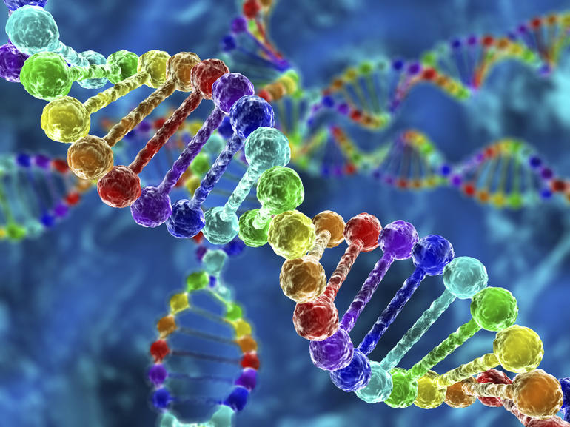
Introduction
There were a series of experiments conducted in 1952 by Alfred Hershey and Martha Chase, confirming that DNA was the genetic material, which had first been demonstrated in the 1944 Avery-Macleod-McCarty experiment. While DNA had been known to biologists since 1869, most assumed at the time that proteins carried the information for inheritance
Hershey and Chase performed their experiments on the T2 phage, a virus whose structure had recently been shown by electric microscope

Slide 3
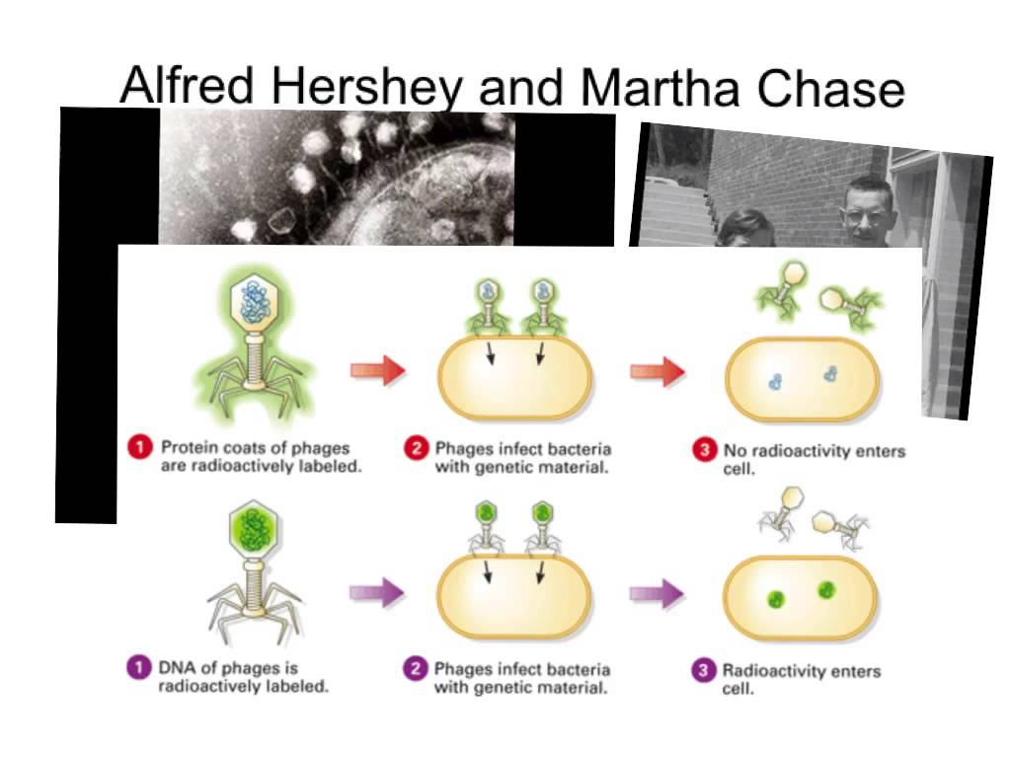

Slide 4
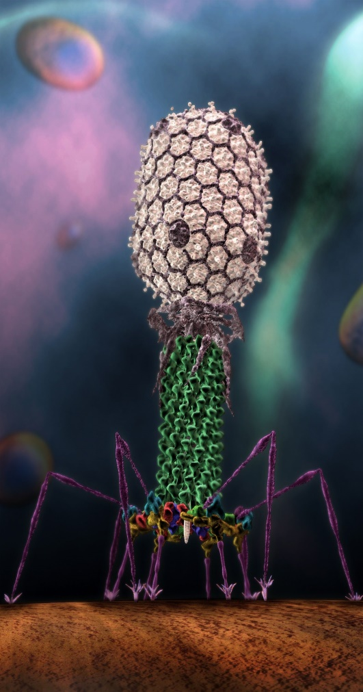
Basic Structure of PGAGE
The phage consists of a protein shell (capsule) containing its genetic material (DNA). The phage infects a bacterium by attaching to its outer membrane and injecting its genetic material and leaving its empty shell attached to the bacterium.
Experiment:
They depend on the differences between protein and DNA chemical structure (DNA: C, H, O, N and P while protein: C, H, O, N, S).
In their first set of experiments, Hershey and Chase labeled the DNA of the phage with radioactive phosphorus³² (the element Phosphorus is present in DNA but not present in any of the 20 amino acids from which proteins are made). They allowed the phage to infect E.coli, and through several elegant experiments were able to observe the transfer of P³² labeled phage DNA into the cytoplasm of the bacterium.

Slide 5
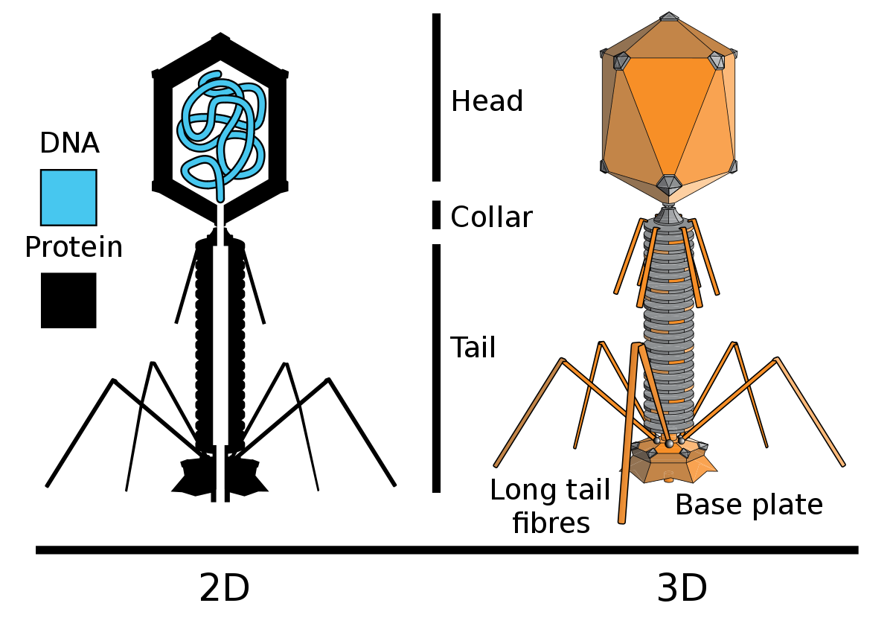
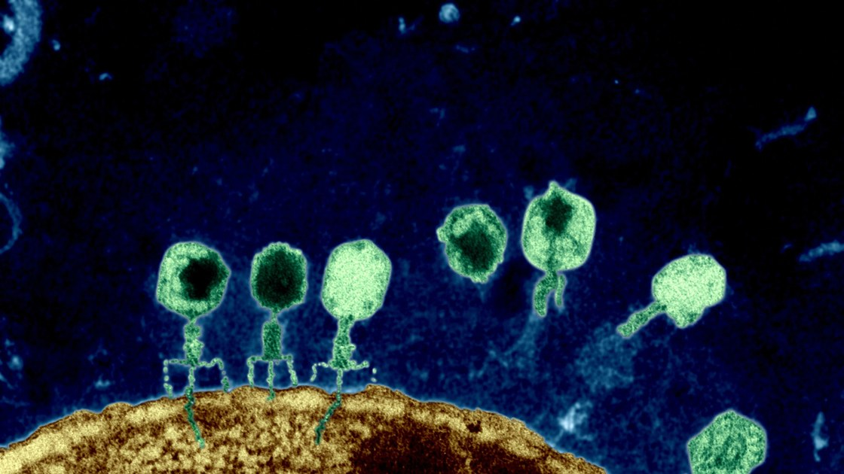

Slide 6
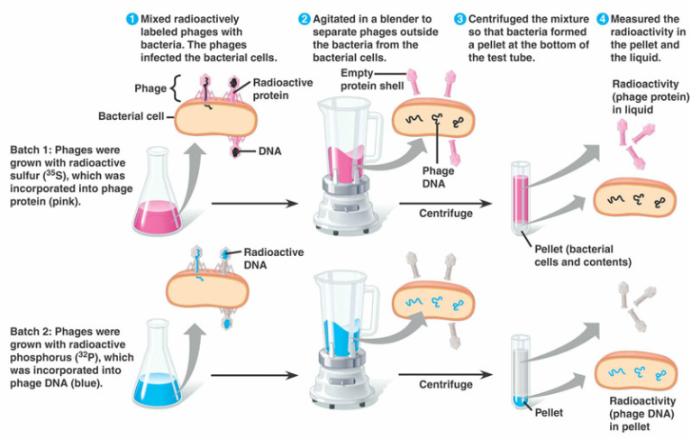

Slide 7
George Beadle, Edward Tatum and Josha Lederberg (1946-1956) Beadle and and Tatum’s key experiments involved exposing the bread mold Neurospora carassa to x-ray causing mutations to cause changes in specific enzymes involved in metabolic pathways. The Nobel Prize in Physiology or Medicine 1958 was divided, one half jointly to Beadle and Tatum “for their discovery that genes act by regulating definite chemical events” and the other half to Jousua Lederberg “for his discovery concerning genetic recombination and the organization of the genetic material of bacteria

Slide 8
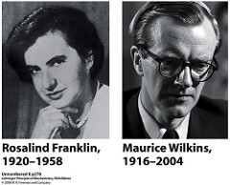
Another important finding in molecular biology science
1950 Rosalind franking and Maurice Wilkins (using X-ray crystallographic equipment to solve the DNA problem at king’s College/ London to determine the 3 dimensional structure of the DNA or protein, according to this A-DNA and B-DNA were described

Slide 9
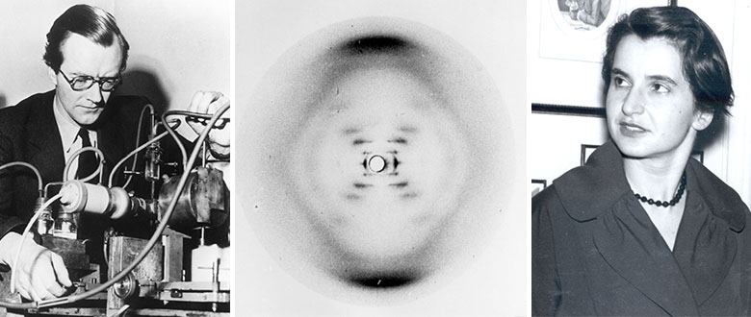
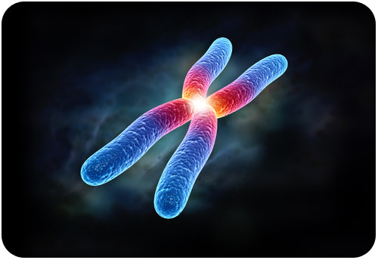

Slide 10
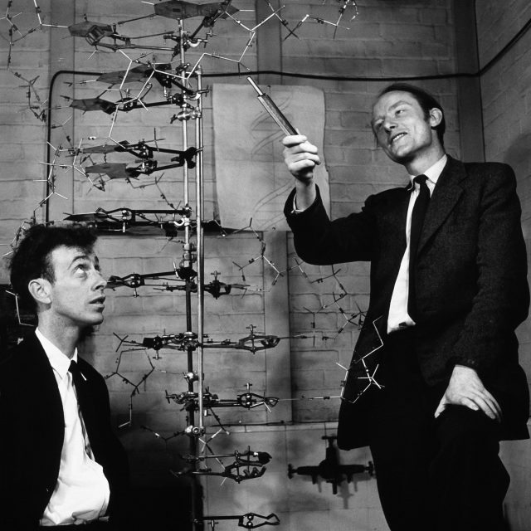
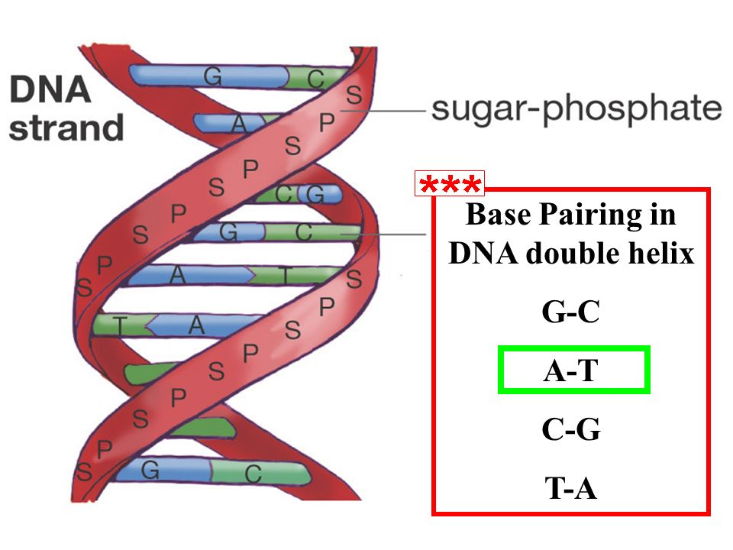
James Watson (USA) and Francis Crick /UK (1953)
Francis Crick, (8 June 1916-28 July 2004) was an English molecular biologist, biophysicist, and neuroscientist, co-discoverer of the structure of the DNA molecule in 1953 with James D. Watson. They depend on Maurice Wilkins X-ray model, so Crick and Watson, together with Maurice Wilkins, won the 1962 Nobel Prize in Medicine for their discovery of the structure of DNA. This was one of the most significant scientific discoveries of the 20th century.

Slide 11
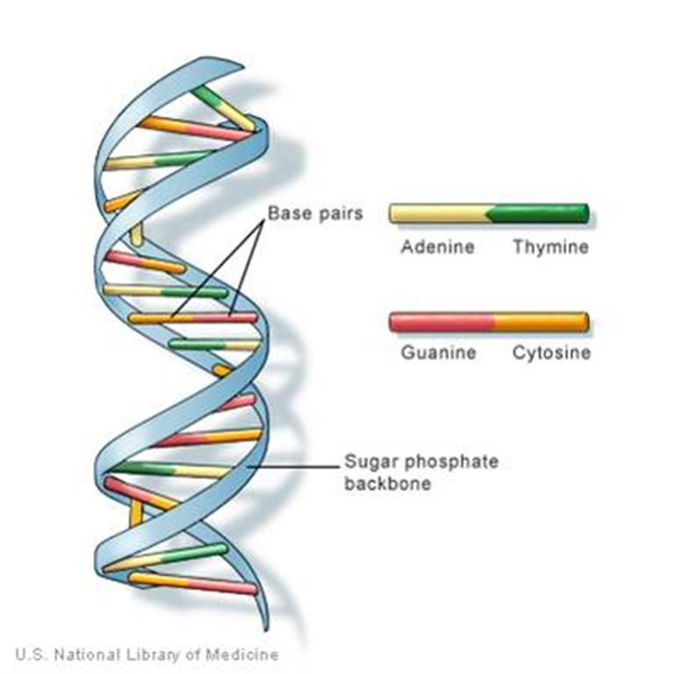

Slide 12
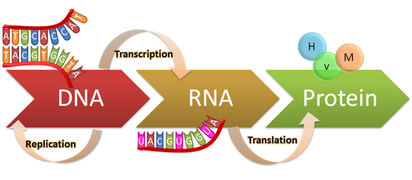
Central dogma of molecular biology
It is the flow of genetic information within a biological within a biological system. It was first stated by Francis Crick in 1958.

Slide 13
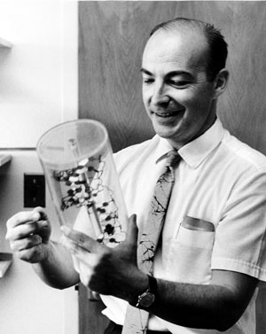
1957 Arthur Kornberg: was an American biochemist who won the Nobel Prize in physiology or Medicine 1959 for his discovery of the mechanisms in the biological synthesis enzyme. His primary research interests in biochemical, especially enzyme chemistry, deoxyribonucleic acid synthesis (DNA replication) and studying the nucleic acids which control heredity in animals, plants, bacteria and viruses

Slide 14
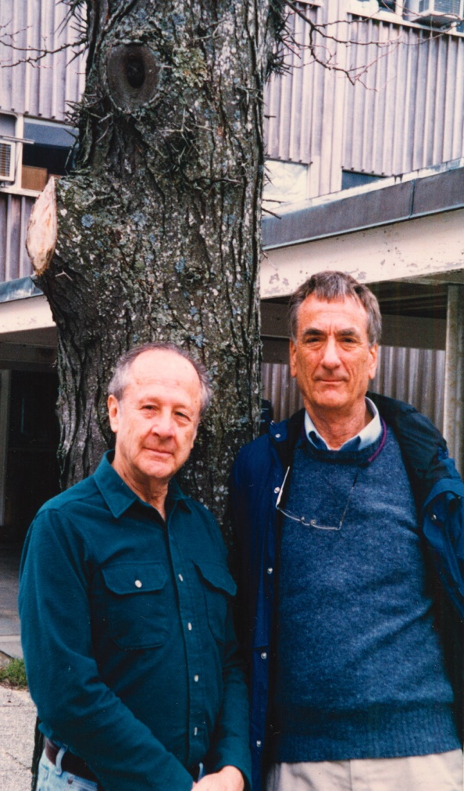
1958 the Meselson-Stahl experiment which supported the hypothesis that DNA replication was semiconservative. In semiconservative replication, when the double stranded DNA helices consisted of one strand from the original helix and one newly synthesized. It has been called” the most beautiful experiment in biology”.

Slide 15
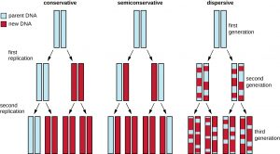
M-S experiment

Slide 16
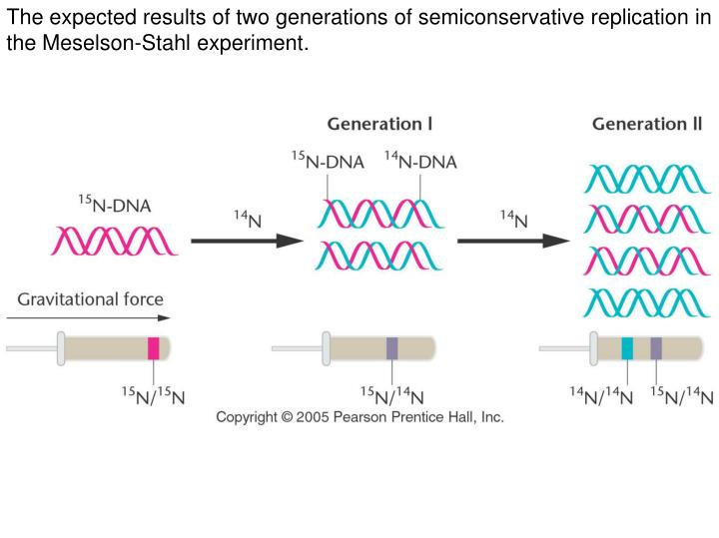

Slide 17
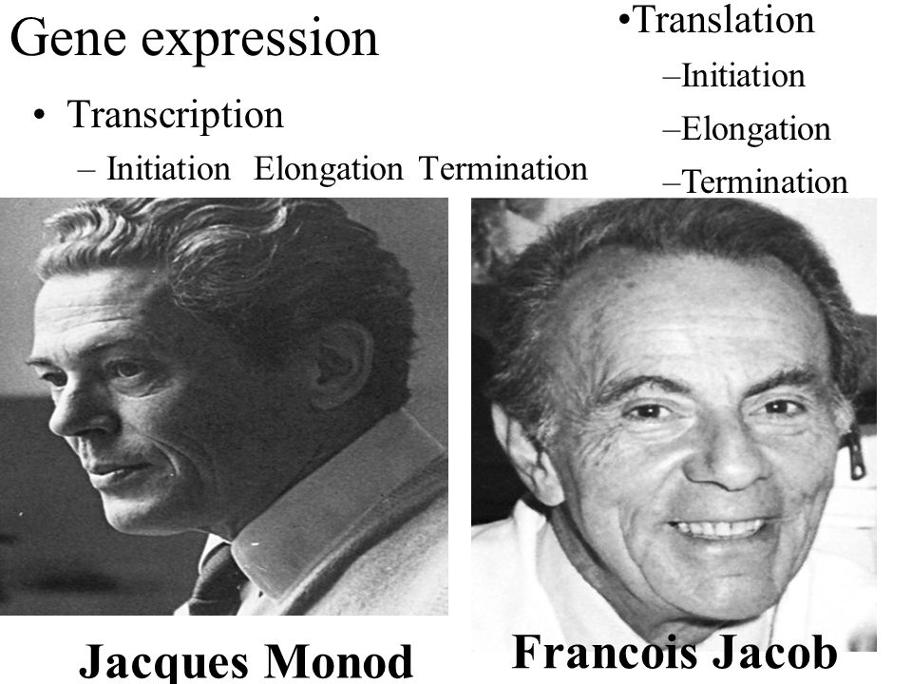
1960 Francois Jacob and Jacques Monod (French biologist): Originated the idea that control of enzyme levels in all cells occurs through regulation of transcription and operon. He shared the 1965 Nobel Prize in Medicine with Andre Lwoff.

Slide 18
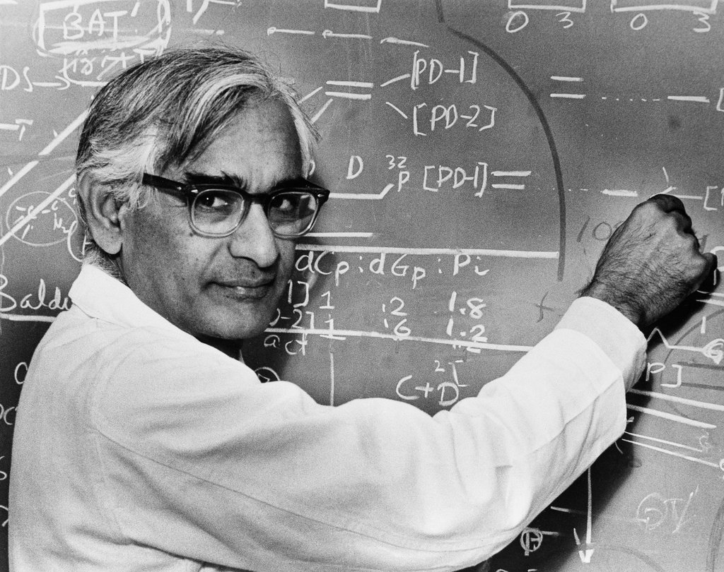
1960 Gobind Khorana was a biochemist who shared the 1968 Nobel Prize for physiology or Medicine with Marshall Nirenberg and Robert Holley for research that helped to show how the nucleotides in nucleic acids, which carry the genetic code of the cell, control the cell’s synthesis of proteins.

Slide 19
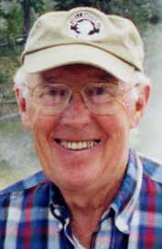


1969 Thomas Brock is an American microbiologist known for his discovery of hyper thermophiles living in hot spring. In the late 1960s, Brock discovered high- temperature bacteria living in the Great Fountain region with his colleague. They isolated a sample named it Thermus aquaticus. By 1976, this bacterium was found useful for artificially amplifying DNA segments. Brock’s discoveries led to great progress in biology, contributed to new developments in medicine and agriculture.

Slide 20
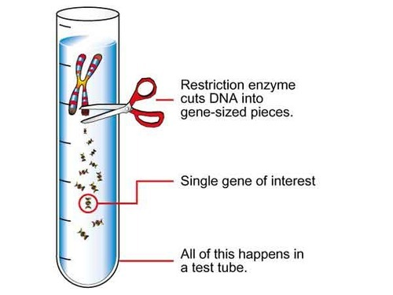
1970: The restriction enzyme studied by Arber and Meselson were type I restriction enzymes which cleave DNA randomly away from the recognition site. In 1970, Hamilton Smith, Thomas Kelly and Kent Welcox isolated and characterized the first type II restriction enzyme, HindII, from the bacterium Haemophilus influenza that cleaves DNA at specific recognition sequence. Later they were awarded Noble Prize for their discovery.

Slide 21



Genetic Engineering, also called genetic modification, is the directed manipulation of an organism’s genome using biotechnology. New DNA may be inserted in the host of interest using molecular methods to generate a modified DNA sequence

Slide 22
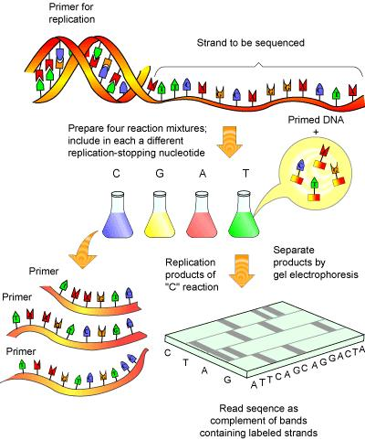
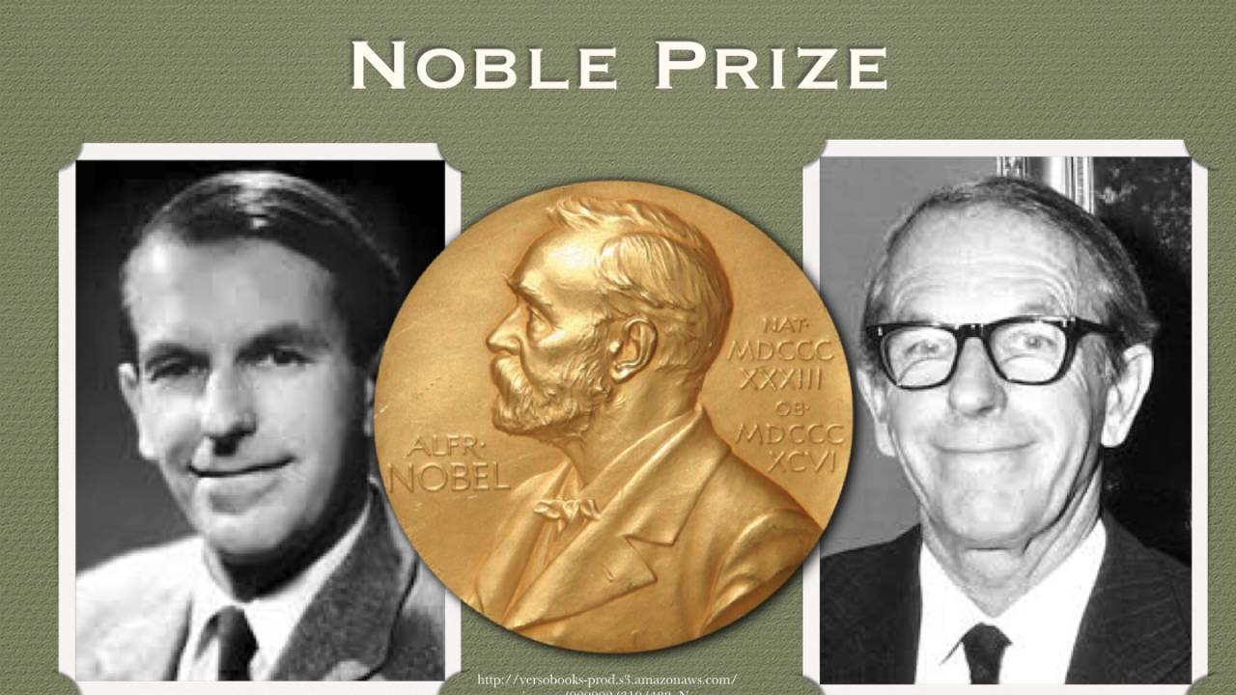
1977 Frederick Sanger a British biochemist who was twice awarded the Nobel Prize for Chemistry, the only person to have been so. In 1958, he was awarded a Nobel Prize in chemistry “for his work on the structure of proteins, especially that of insulin”.

Slide 23
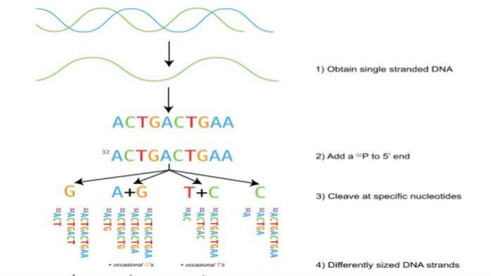
In 1980, a method of DNA sequencing developed by Allan Maxam and Walter Gilbert. This method is based on nucleobase- specific partial chemical modification of DNA backbone at sites adjacent to the modified nucleotides.

Slide 24
In 1983 Kary Mullis American chemist started using a pair of primers to synthesis a desired DNA sequence and to copy it using DNA polymerase, a technique which would allow a small strand of DNA to be copied almost an infinite number of times. A complication at that point was that the DNA polymerase since it was destroyed by the high heat used at the start of each replication cycle, so it had to be replaced. In 1986, Mullis started to use Thermophilus aquaticus (Taq) DNA polymerase to amplify segment of DNA.

Slide 25
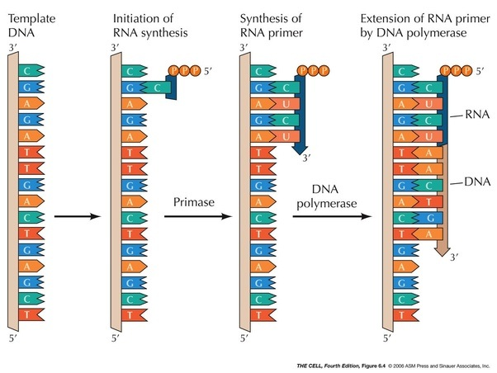

Slide 26


